Slide 1
Cruise Ship Management System
Using HTML, CSS, JS, and FireBase

Slide 2
Introduction
Overview: A web application designed to manage cruise ship operations efficiently, allowing voyagers to place orders for various services, such as catering, stationery, resort bookings, fitness center reservations, and party hall bookings.
Target Users: Voyagers, Administrators, Managers, Head-Cooks, Supervisors.
Objective: Improve the customer experience by enabling voyagers to book and order services from their devices without visiting multiple departments.

Slide 3
Objective statement
Present Challenge: Travelers are required to visit multiple departments for services, which is both inefficient and time-consuming.
Proposed Solution: Create an online platform that allows travelers to place orders and reserve services, such as:
Catering: Snacks, meals, and drinks
Stationery: Gifts, chocolates, and storybooks
Tickets: Reservations for resorts, movies, beauty salons, fitness centers, and event halls
Event Hall: Booking for various events like birthdays, weddings, and more

Slide 4
System components
1. Voyager
Login: Username and password-based authentication
Services:
Catering Orders: Choose snacks, food, and beverages.
Stationery Orders: Select gift items and other stationery.
Bookings: Make reservations for resort-movies, beauty salon, fitness center, and party hall.
2. Admin
Admin Login: Username and password-based authentication.
Functions:
Item Management: Add, edit, or delete menu items and other services.
Voyager Registration: Manage voyager accounts.
3. Manager
View Bookings: Track booked resort-movie tickets, beauty salon appointments, fitness center schedules, and party hall reservations.
4. Head-Cook
Catering Orders: View and manage catering orders made by voyagers.
5. Supervisor
Stationery Orders: View and manage stationery item orders made by voyagers

Slide 5
Project Framework and Blueprint
Frontend Design:
UI/UX: An intuitive and aesthetically pleasing interface that adapts seamlessly to various screen sizes and devices.
Features: User login functionality, service search capabilities, interactive navigation menus, and booking forms for easy use.
Backend Design:
Database: Firebase is employed to store essential data, including user information, booking records, and order details.
Authentication: Firebase Authentication ensures secure user logins for different roles such as voyagers, administrators, and managers.
Logging: JavaScript’s console.log or Python’s logging module is used to track user activities and system operations.
Optimization:
Code Level: A modular coding approach is followed to enhance maintainability and scalability of the application.
Architecture Level: The database is organized efficiently, with distinct collections for users, bookings, catering services, and stationery items.

Slide 6
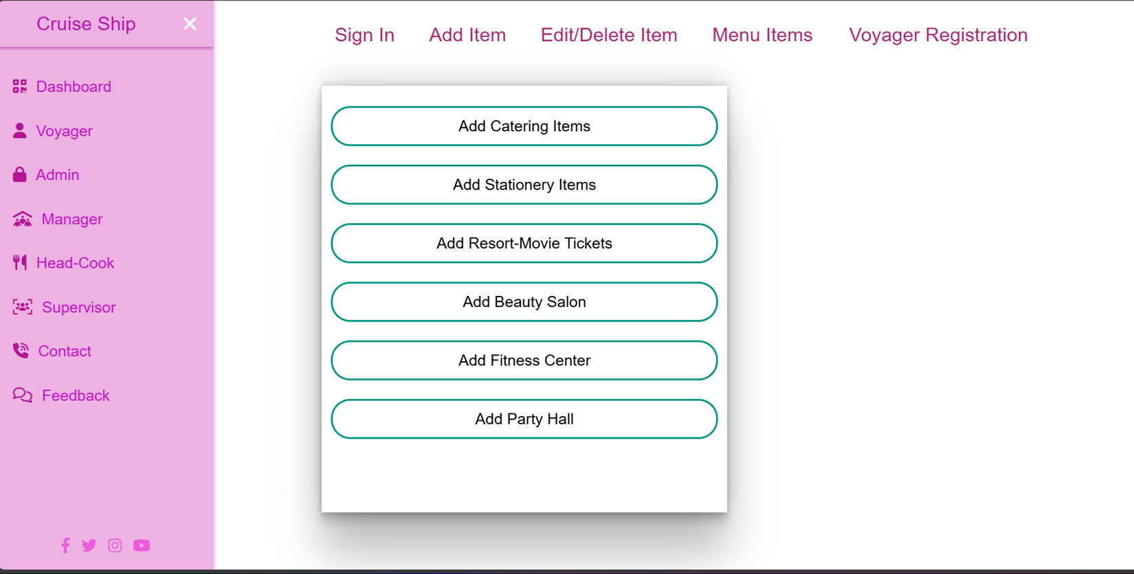

Workflow Process
Workflow Process

Slide 7
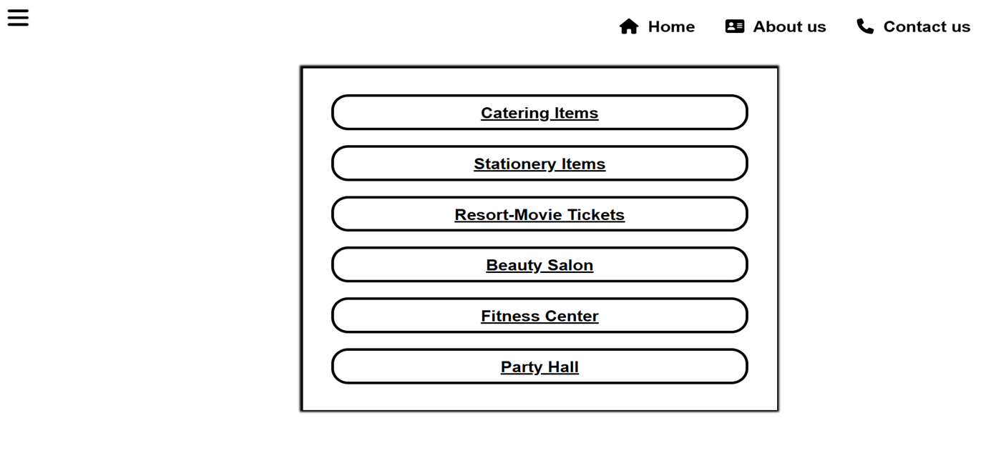
1.Voyager Journey
Sign In: The voyager enters their username and password to log in. Choose Services: Once logged in, the voyager picks the desired service (e.g., Catering, Stationery, Resort Movie). Make Reservations: The voyager confirms their selection by placing an order for the chosen services.

Slide 8
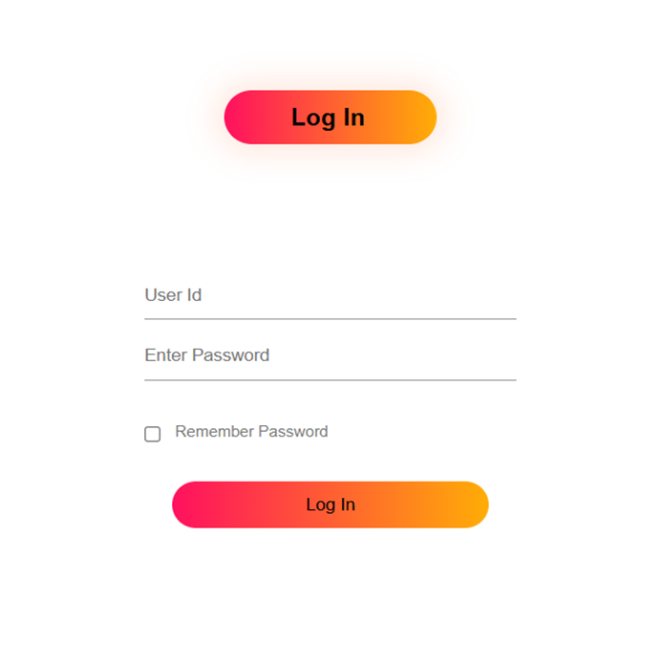
2.Management Workflow
Login: The administrator logs in to oversee the system.
Item Management: The administrator can insert, modify, or remove products from the catalog (such as food, beverages, books, etc.).
Account Administration: The administrator has access to view and manage voyager accounts.

Slide 9
3.Administrator workflow
Booking Overview: Managers can view a list of all reserved services (such as movie tickets, fitness sessions, beauty salon appointments, etc.).
4.Cooking Process Management
Catering Order Overview: The Head-Cook oversees catering requests, preparing them according to voyager preferences.
5.Management Flow
View Stationery Orders: Supervisor ensures timely delivery of ordered stationery items.

Slide 10
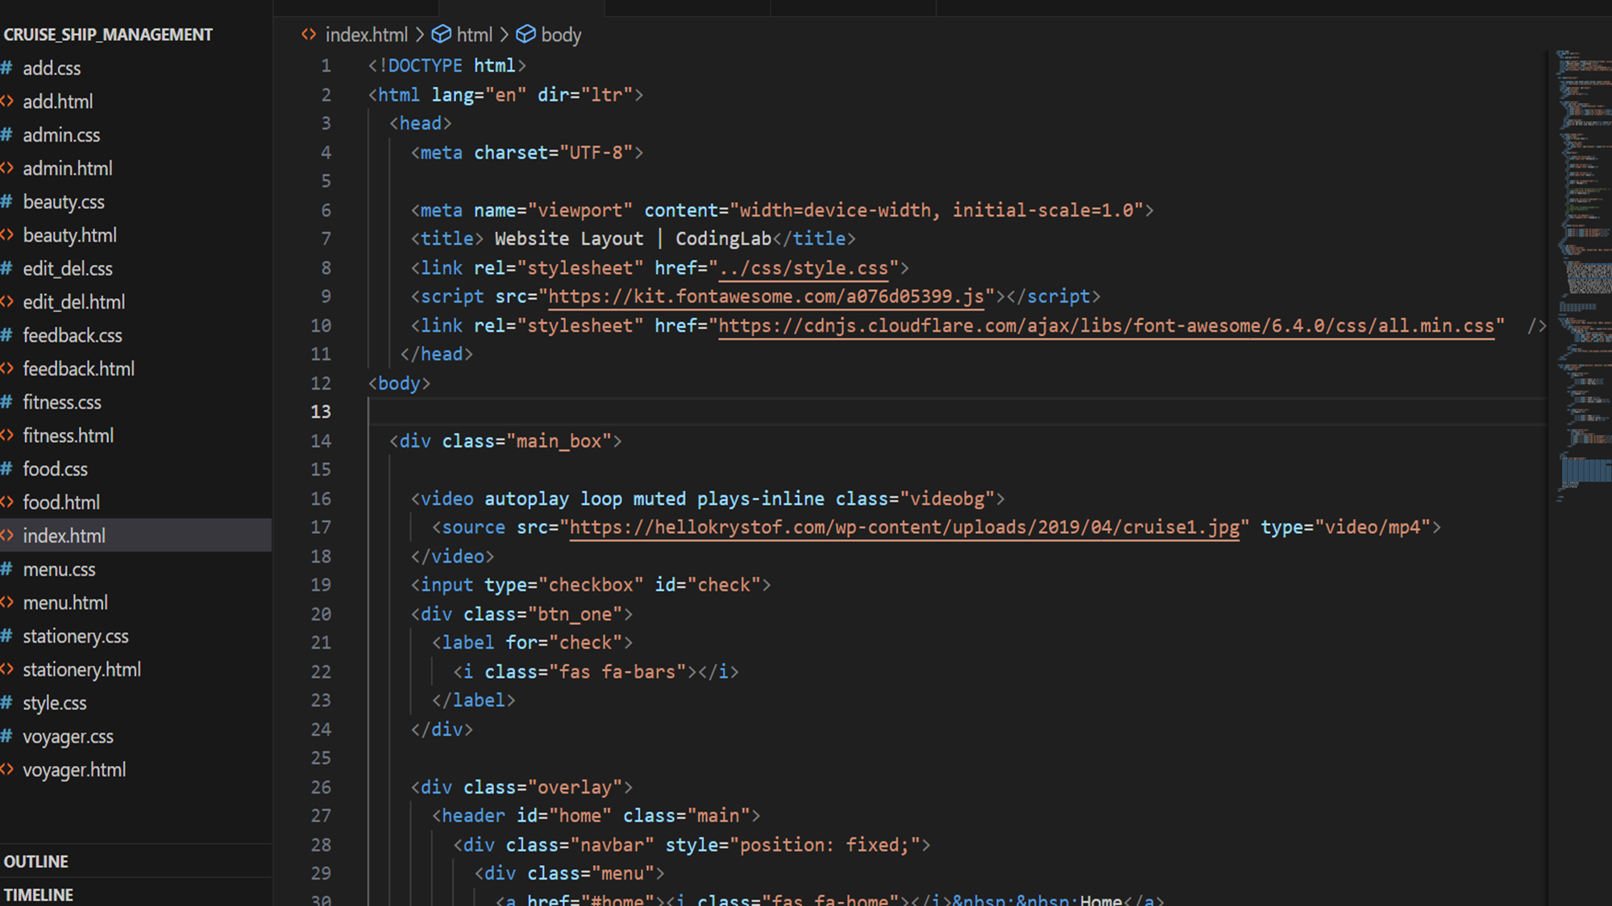

Slide 11
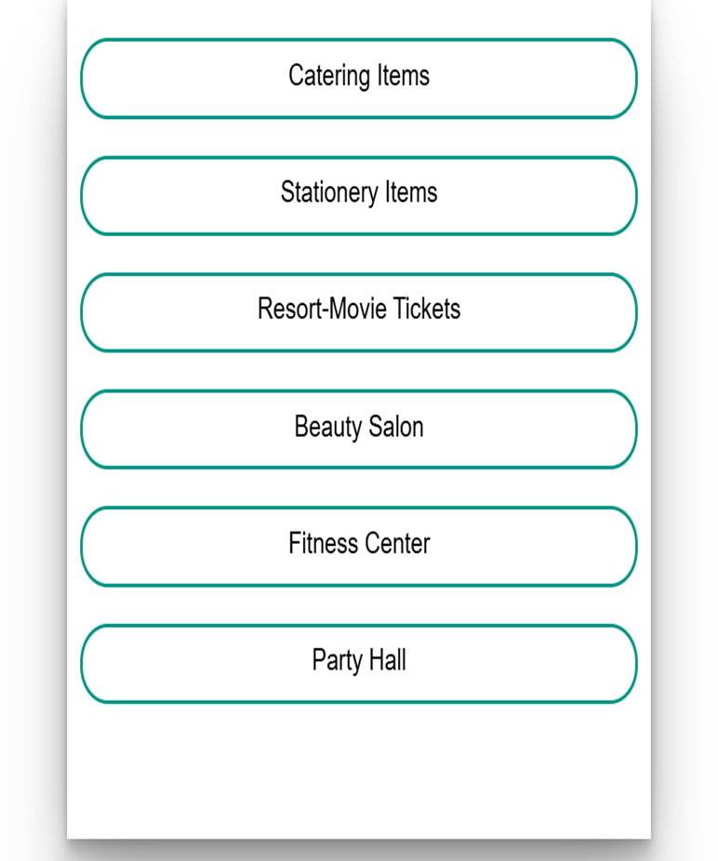
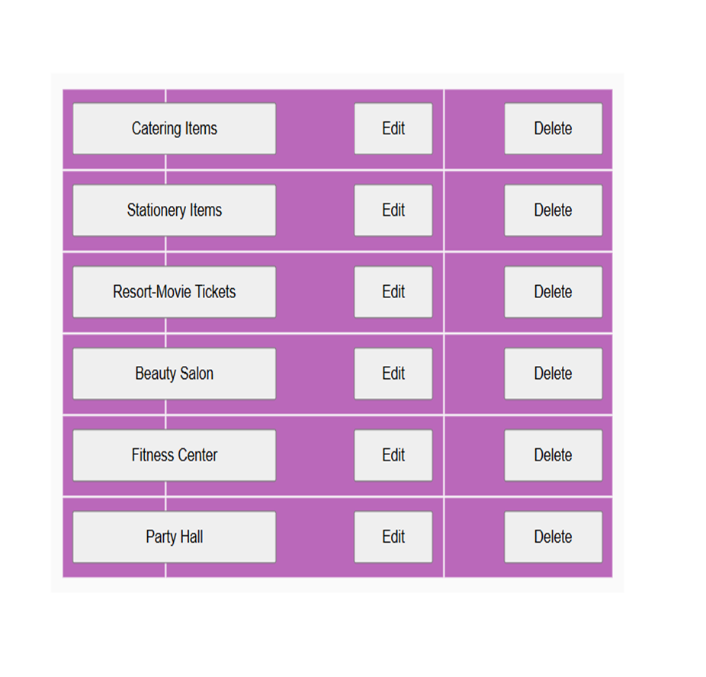

Slide 12
Core Attributes
Voyager Login: Secure sign-in for voyagers to safeguard user information. Instant Booking: Users can reserve services and instantly view available timeslots. Order Tracking: The system facilitates straightforward handling of catering and stationery orders. Service Accessibility: Verify the availability of movie tickets, gym slots, and event spaces prior to booking. Activity Logging and Monitoring: All user and system actions are recorded for troubleshooting and oversight.

Slide 13
conclusion
Impact: This system improves the voyager experience by offering seamless access to services and optimizing operations for the cruise management team. Learning Outcome: The project demonstrates the practical application of Firebase for handling real-time data, user authentication, and implementing a flexible web design.

